Slide 1
Decoding Digital Desires: a Data Driven Analysis of Bangladesh's Smartphone Universe
File created on: 8/31/2025 5:28:06 PM

Slide 2
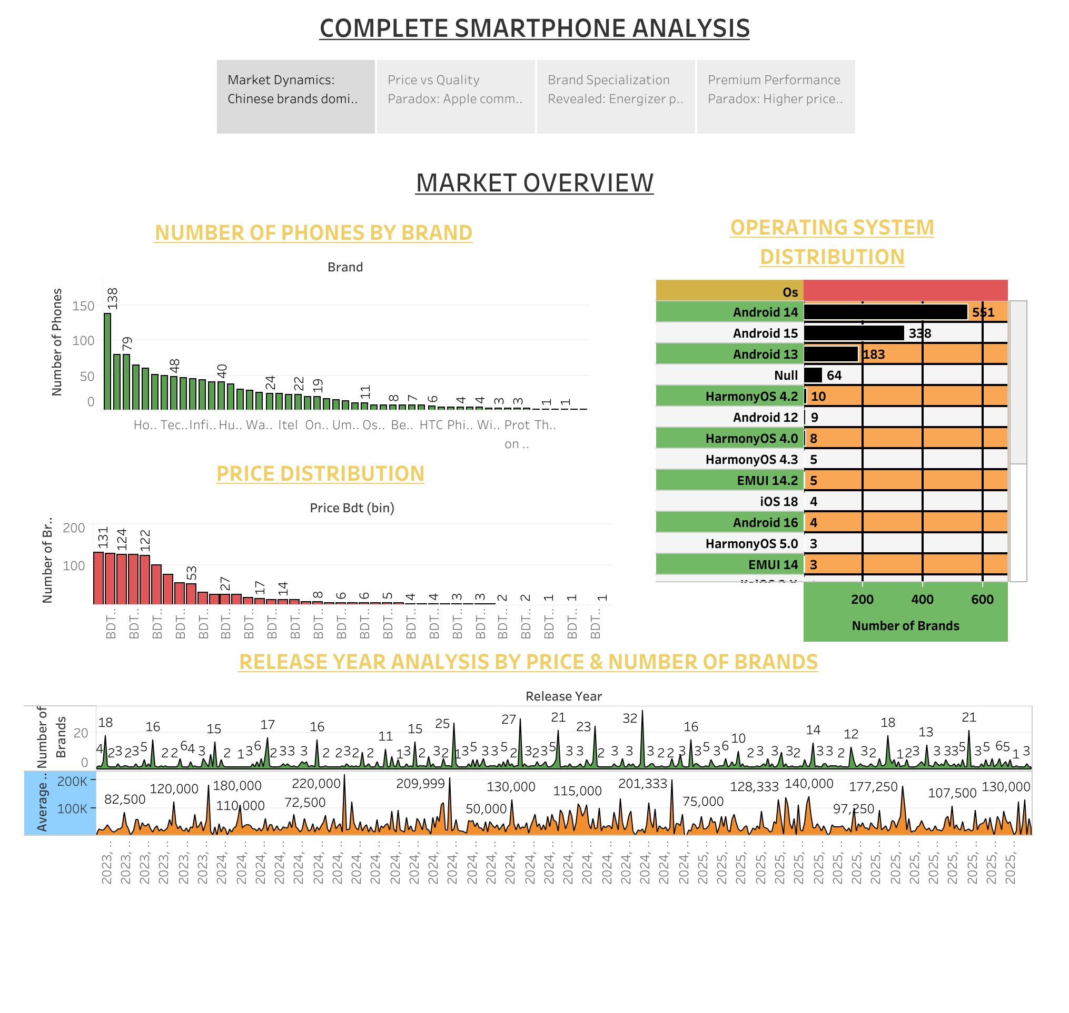

Slide 3
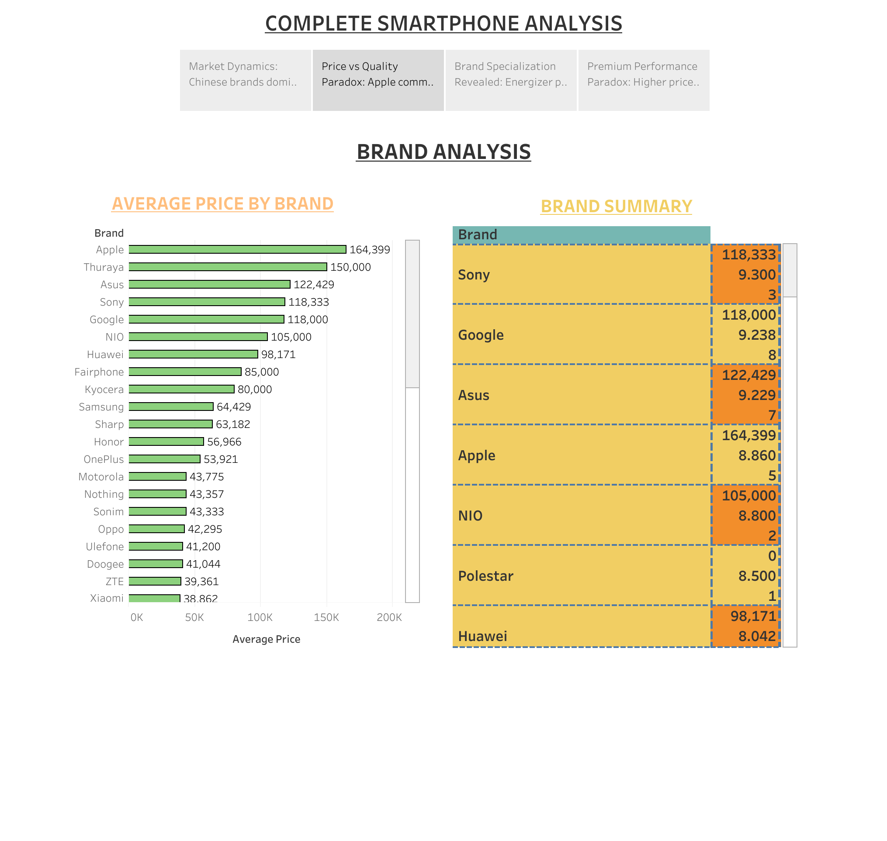

Slide 4
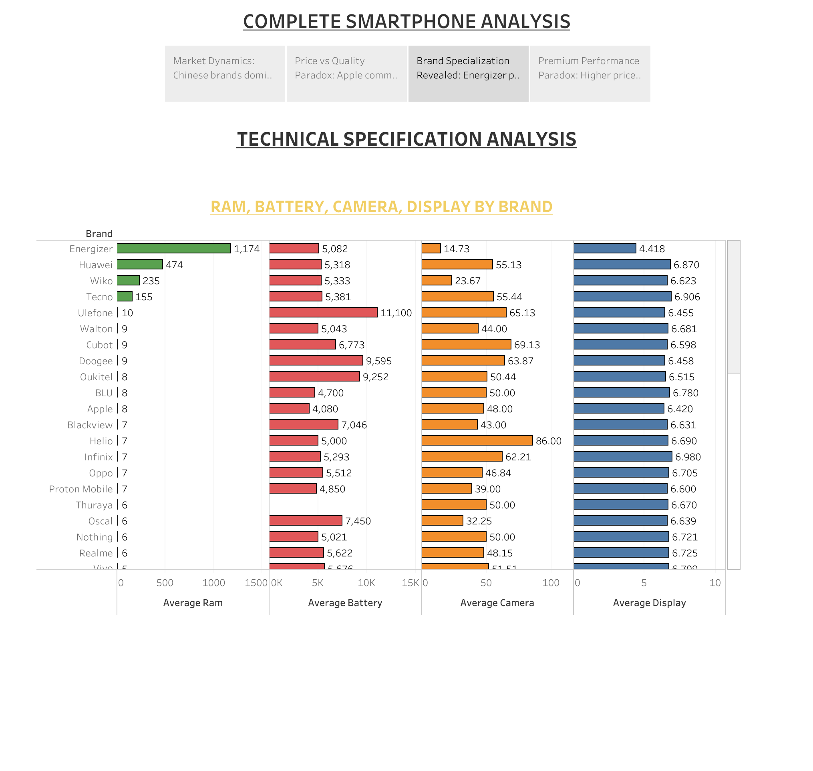

Slide 5
